Slide 1
Inventory Management System
Submitted by :
Gayatri Baragi
Anusha R

Slide 2
Introduction
Inventory is the stock of physical items such as materials, components , work in progress, finished goods etc, Inventory is the merchandise that is purchased and or produced and stored for eventual sale.
An inventory would include items which are held for sale in the ordinary course of business or which are in the process of production for the purpose of sale or which are to be used in the production of goods or service which will be for sale.
The main objective of inventory management is to maintain inventory at appropriate level to avoid excessive or shortage of inventory because both the cases are undesirable for business.
Inventory management should follow following objectives:
To keep inventory at sufficiently high level to perform production and Sales activities smoothly.
2) To minimize investment in inventory at minimum level to maximize Profitability
The inventory management system is used for purposes, including: Maintaining and recording the information between too much and too little inventory in the company. Keep track of stock. Recording product information in a warehouse or other location. Having a record of Picking, packing, and selling

Slide 3
Literature Survey
“Principles of Inventory Management” by Max Muller and Tom F. Wallace:
This book is considered a foundational resource for inventory management. It covers a wide range of topics, from basic concepts to advanced techniques, making it suitable for both beginners and experts.
“Inventory Management: Principles, Concepts, and Techniques” by F. Robert Jacobs and Richard B. Chase:
This text offers a comprehensive overview of inventory management principles and practices . It includes discussion on various inventory models and their application.

Slide 4
Proposed system
Proposed system is a software application which avoids more manual hours that need to spend in record keeping and generating reports.
This application keeps the data in a centralized way which is available to all the users simultaneously.
It is very easy to manage historical data in database.
No specific training is required for the employees to use this application.
They can easily use the tool that decreases manual hours spending for normal things to maintain the stocks of the various items.
Advantages:
Easy to manage all the daily transactions
Can generate required reports easily
Easy to manage historical data in a secure manner
Centralized database helps in avoiding conflicts
Easy to use GUI that does not requires specific training

Slide 5
Specific Requirements
Hardware Requirements:
Processors: Intel core i3 processor or above.
Disk space: 1GB or more
Operating System: Windows 10 or above
Software requirements:
Editor: PyCharm
Database: sqlite3
Frontend: Python

Slide 6
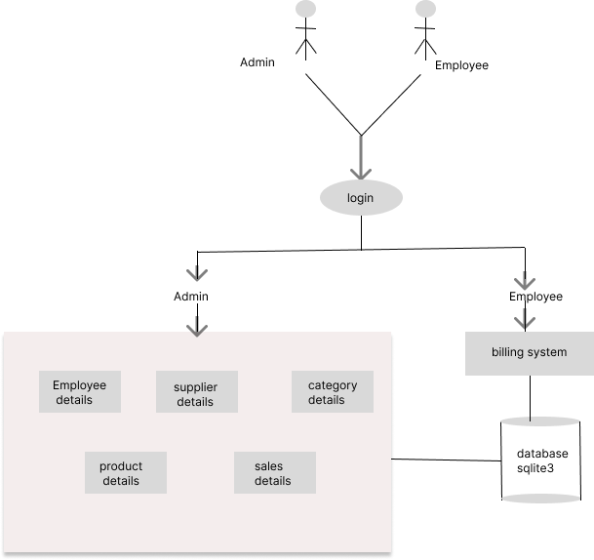
System architecture

Slide 7
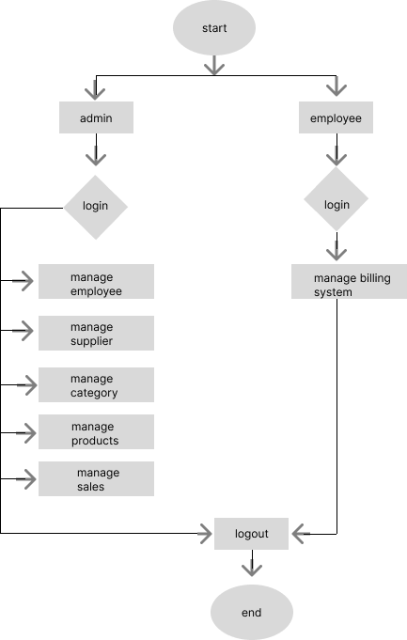
Work Flow Diagram

Slide 8
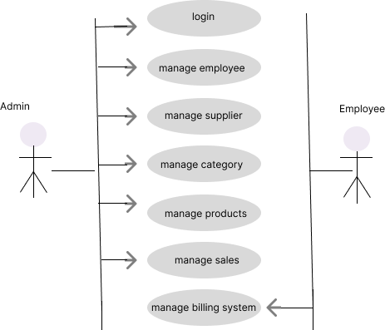
Use case Diagram
.

Slide 9
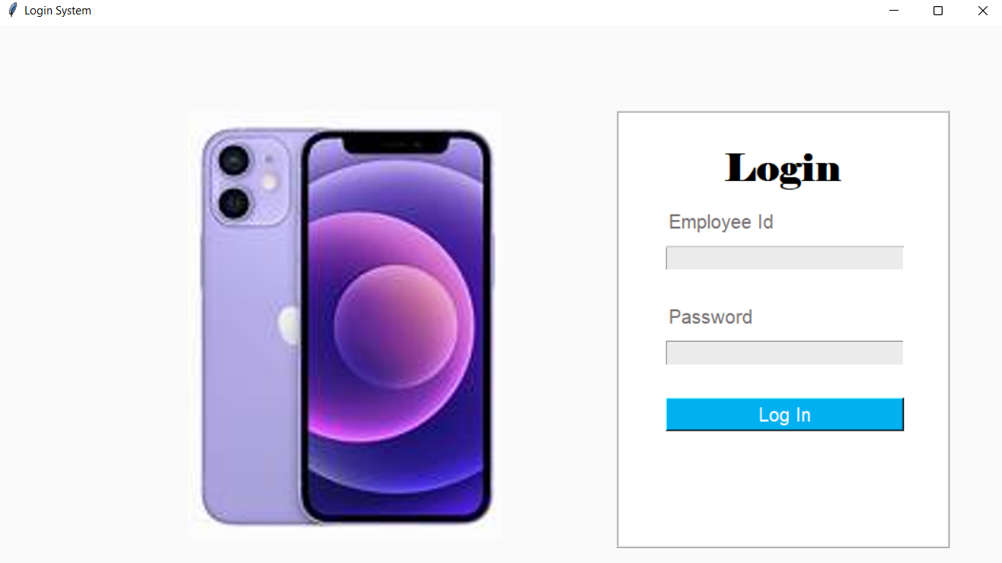
Screen Shots
.

Slide 10
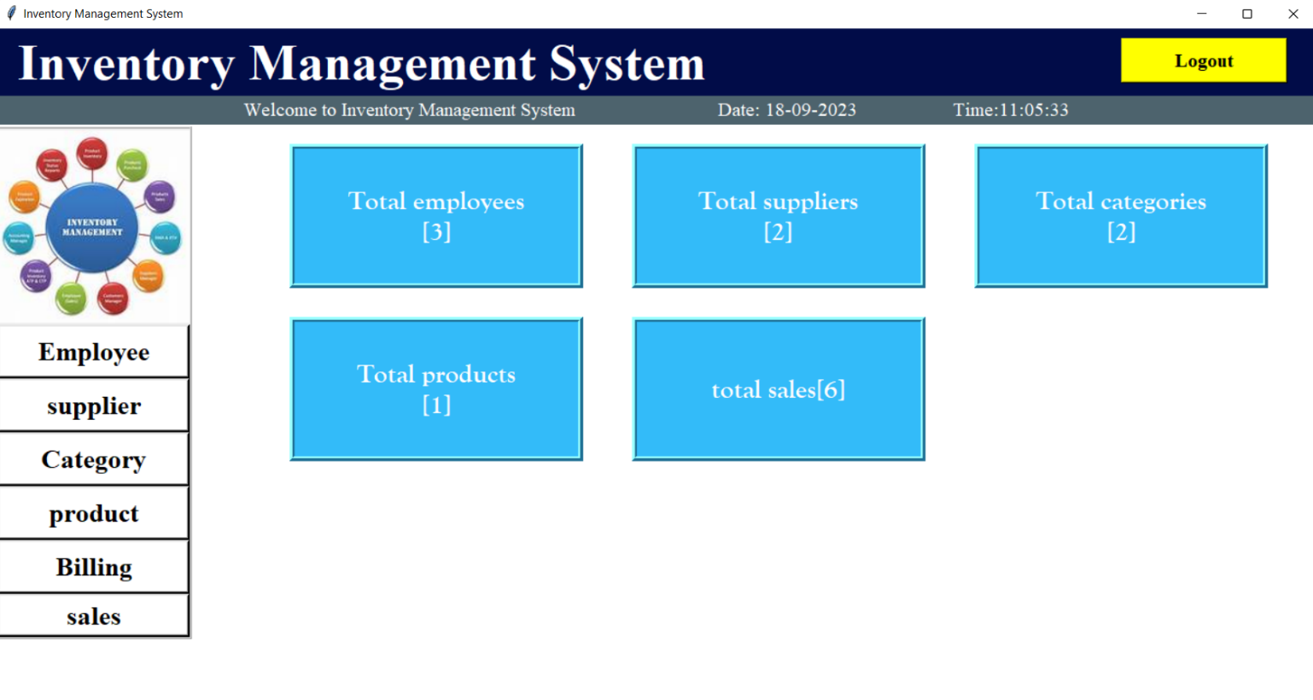
.

Slide 11
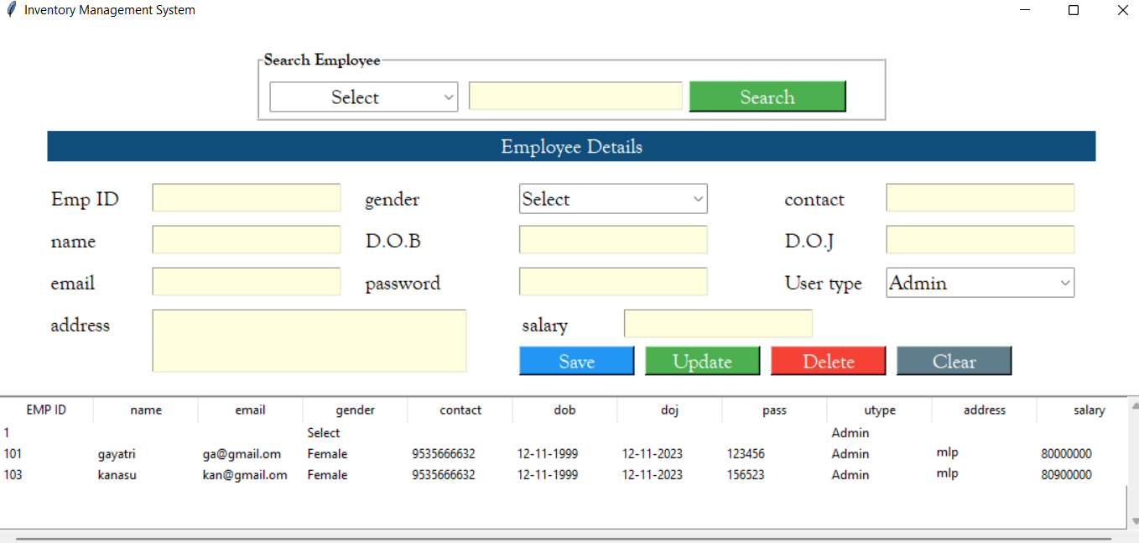
.

Slide 12
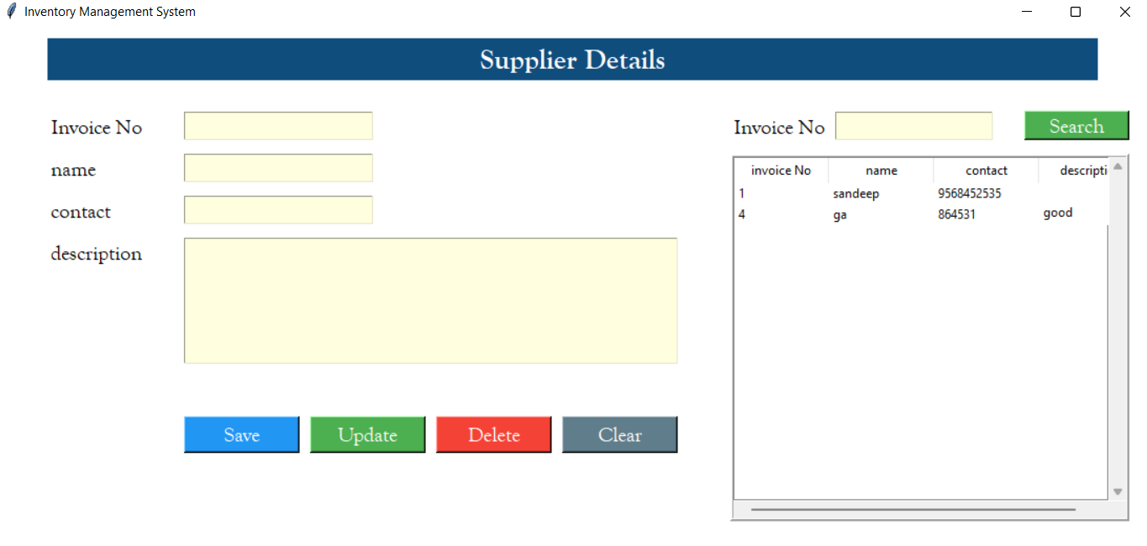
.

Slide 13
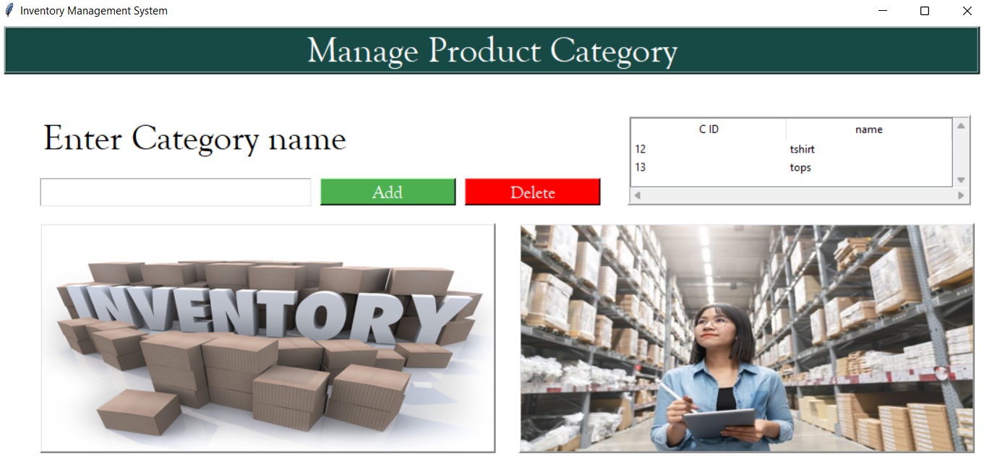
.

Slide 14
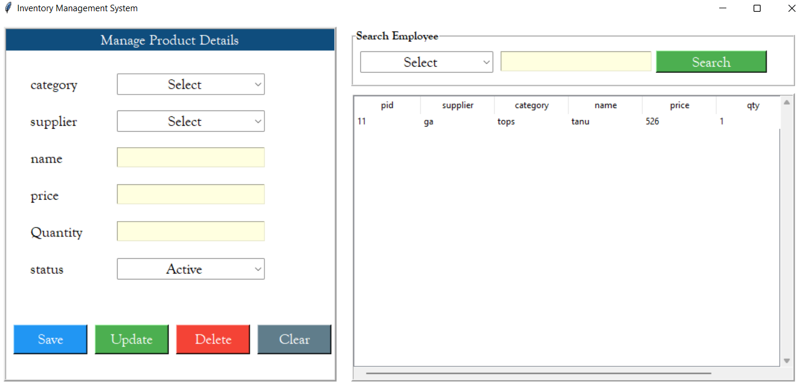
.

Slide 15
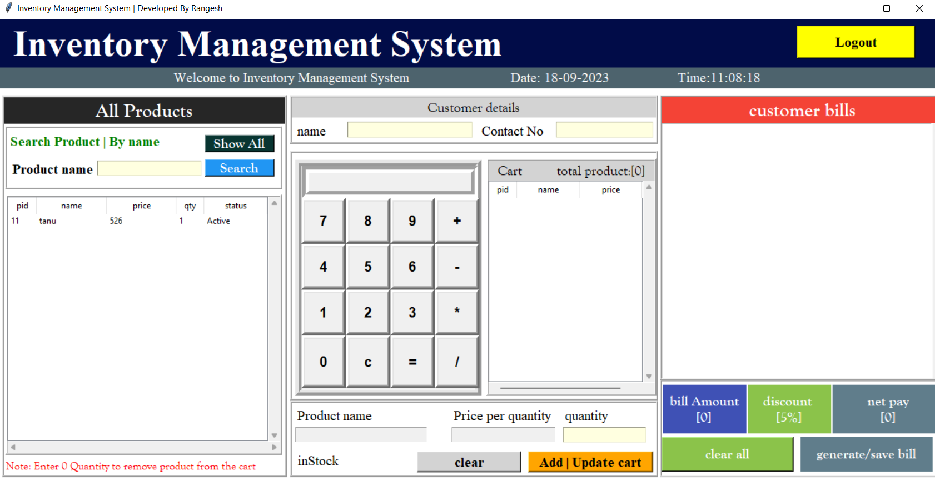
.

Slide 16
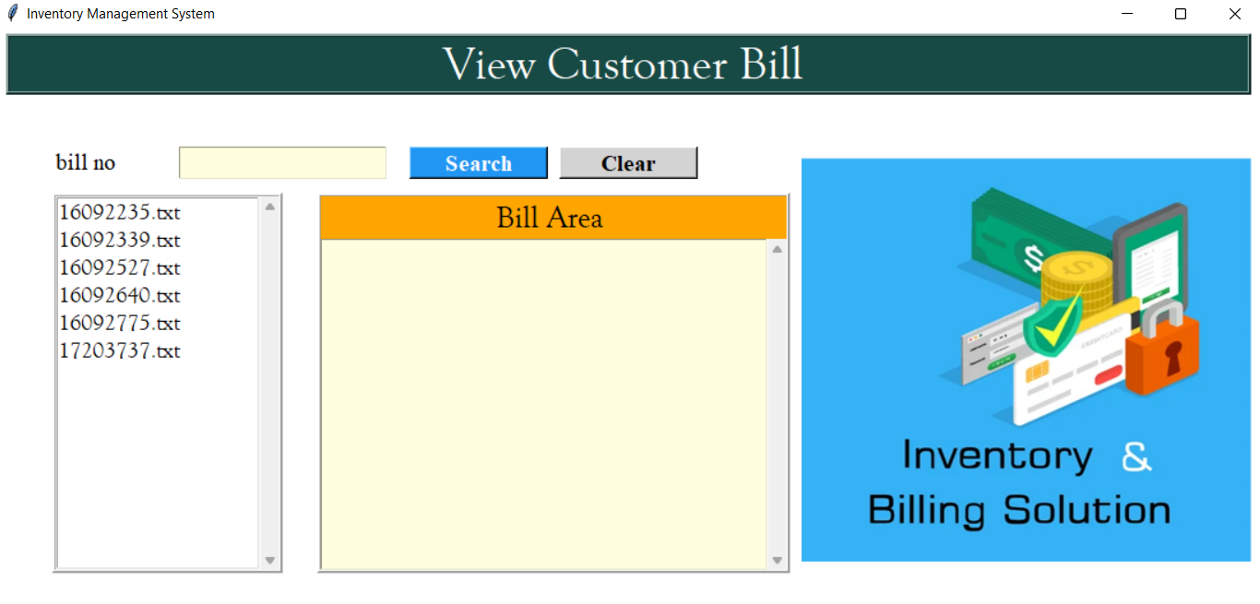
.
.

Slide 17
Conclusion
The development and implementation of the inventory management system have been a significant milestone for our organization, This project undertook the primary goal of optimizing our inventory control processes, improving efficiency, ultimately enhancing our overall business performance.
The IMS (inventory management system) has successfully improved inventory accuracy by automating data entry, reducing manual errors , and providing real-time tracking of stock levels. This has resulted in Reduced stock outs, overstock situations, and associated financial losses.
The IMS has reduced the time and effort required to track, this has freed up valuable human resources for more strategic tasks.
With stock availability and faster order fulfilment , our customers have experienced an enhanced level of service, resulting in higher customer satisfaction and loyalty

Slide 18
Future Enhancement
AI and Machine Learning:
Explore the use of AI and machine Learning algorithms for more advanced inventory optimization, including dynamic pricing, demand sensing.
Feedback Mechanism:
Establish feedback mechanisms for users to submit suggestions and report issues, fostering continuos improvement and user engagement.

Slide 19
.
THANK YOU

